Slide 1
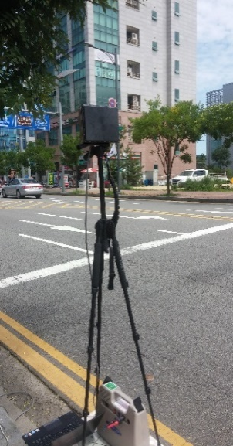
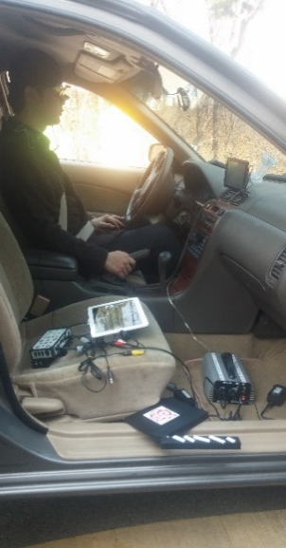
Observation and experiment of driving behaviors
near speed humps and speed tables
Jiho Yeo, Junhan Cho, Hoyoung Lee, Dong-Kyu Kim, Kitae Jang
Objective
Investigate the effects of speed humps and tables on vehicle speeds under high-speed conditions
Assess human factors that affect speed-reduction patterns of drivers
Data & Study site
East pangyo Street in the city of pangyo
Both observation & experiment were conducted
Observation
→ With Radar detecting vehicle speeds every 75ms
→ Collect speed profiles of passing vehicle
Experiment
→ Evaluate drivers’ perception & reaction
[UMRR radar (left) and
equipped car for experiment (right)]

Slide 2
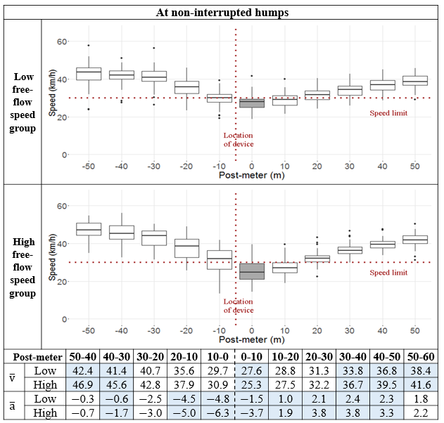
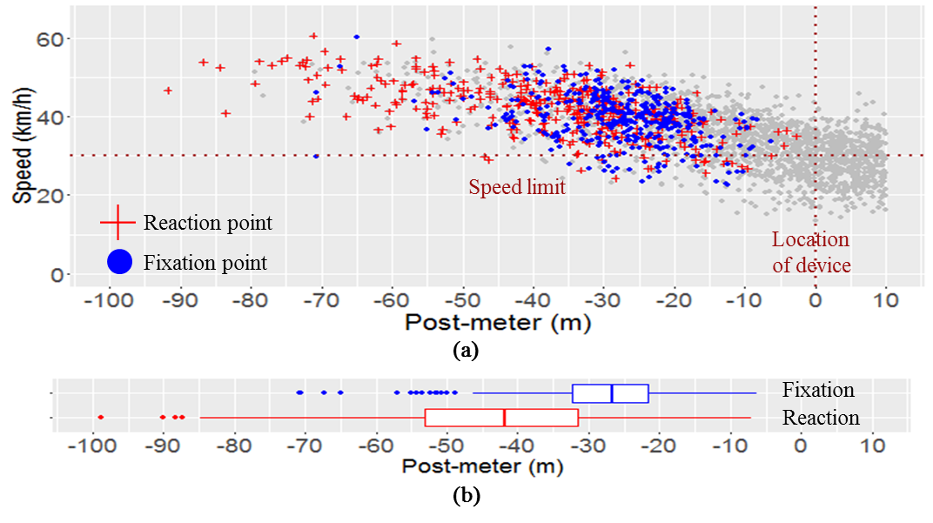
Result
Conclusion
Closely-installed devices effectively stabilize the vehicle speeds
Drivers with high speed tend to change the speed more abruptly
→ These abrupt behaviors were prominent in isolated speed control devices
→ Suggesting the need of consecutive speed control devices
Drivers started to reduce their speeds before fixating eyes on the devices
→ Fixating times doesn’t differ by physical surroundings & type of devices
Compare speed profiles
using paired t-test
Analyze eye fixation & drivers’ reaction

